Slide 1
PSCS_46_Application for Assessment of Quality of Textbook/ Reference Books/ E-Books
CSE 7101- Capstone Project
Review-5
Batch Number: CSE_23
Roll Number | Student Name
Under the Supervision of
Ms. Kummara Sruthi
Assistant Professor
School of Computer Science and Engineering
Presidency University
20221CSE0234 | Syed Thousif
20221CSE0211 | Patil Jashwanth Reddy
20221CSE0213 | Kambam Nithin Kumar Reddy
Name of the Program: CSE-Computer Science and Engineering
Name of the HOD: Dr. Asif Mohammed, Dr. Blessed Prince
Name of the Program Project Coordinator: Mr. Muthuraju V
Name of the School Project Coordinators: Dr. Sampath A K , Dr. Geetha A

Slide 2
Content
Problem Statement
Analysis of Problem Statement
Abstract
Literature Survey
Objectives
Existing Methods
Drawbacks
Analysis and Design
Proposed method & Feasibility Study
Architecture Diagram
Modules
Hardware and software details
Working Screenshot
Git hub Link
Timeline of the Project
References

Slide 3
Problem Statement
Quality assessment of textbooks, reference books, and e-books is manually done.
Manual review is time-consuming, subjective, and inconsistent.
Institutions lack a standard, automated method to measure content accuracy and readability.
There is a need for a system that can analyze text/images of textbook pages and give objective scores.

Slide 4
Analysis of problem Statement
Academic content varies widely in style, accuracy, and complexity.
Human reviewers face challenges in evaluating large volumes of study material.
Many materials are available only as scans or images, requiring OCR-like processing.
A unified platform is required to support multiple formats and produce consistent evaluation metrics.

Slide 5
Abstract
This project presents an AI-driven system that evaluates the quality of textbooks, reference books, and e-books.
The system accepts PDF, DOCX, TXT, and camera-captured images.
Google Gemini is used to compute accuracy, readability, consistency, and generate a summary.
MongoDB stores user data, files, and evaluation history using GridFS.
The system provides a quick, automated, and reliable tool for academic content assessment.

Slide 6
Literature Survey
Existing studies show AI can assist in text analysis, readability scoring, and semantic evaluation.
LLMs like GPT/Gemini have shown strong performance in content comprehension and summarization.
Education technology research highlights the need for automated quality metrics for textbooks.
Prior methods rely heavily on static rules or simple readability formulas, lacking contextual understanding.
Few systems combine AI evaluation + document upload + camera capture into a unified solution.

Slide 7
Objectives
Automate textbook quality assessment using AI
Provide objective scores for accuracy, readability, and consistency
Support multiple input types (files + camera images)
Maintain user-specific evaluation history
Reduce workload of academic reviewers and improve decision-making
Ensure scalability and ease of use for educational institutions

Slide 8
Existing Methods
Manual textbook review by experts
Readability-based tools (Flesch–Kincaid, Gunning Fog Index)
OCR tools for scanned documents
Basic plagiarism scanners or content checkers
Keyword matching / rule-based analysis

Slide 9
Drawbacks of existing methods
Manual review is slow and subjective
Existing readability tools skip content accuracy
OCR tools do not evaluate text quality
Rule-based methods cannot understand context
No support for scanned textbook pages in a unified platform
Lack of centralized history and data storage

Slide 10
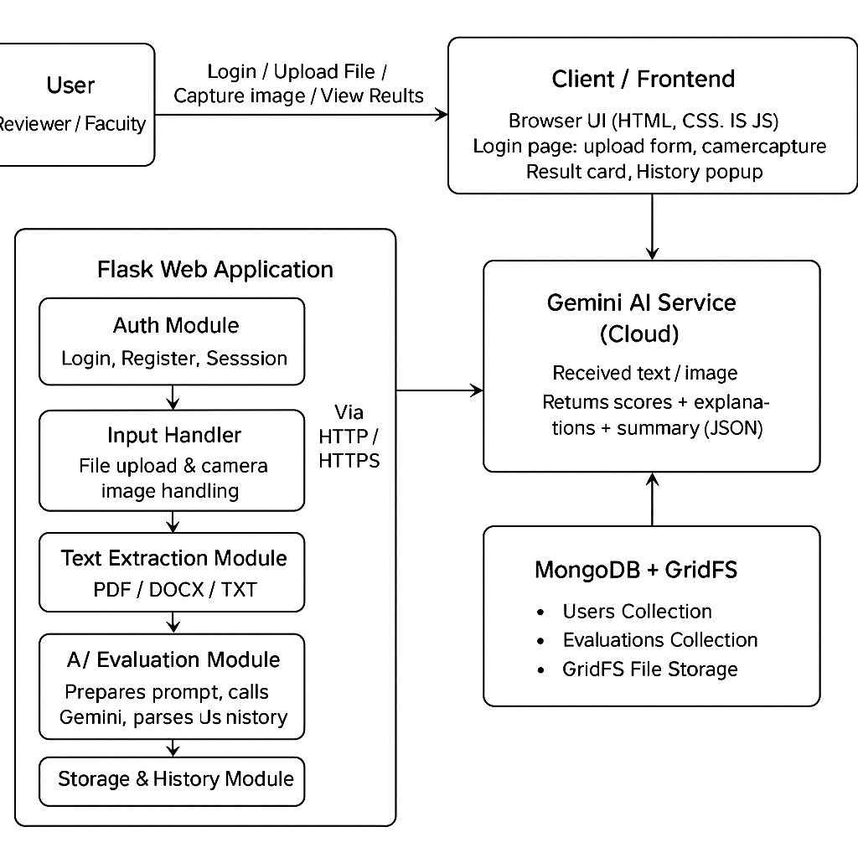
Analysis and Design
Block Diagram:

Slide 11
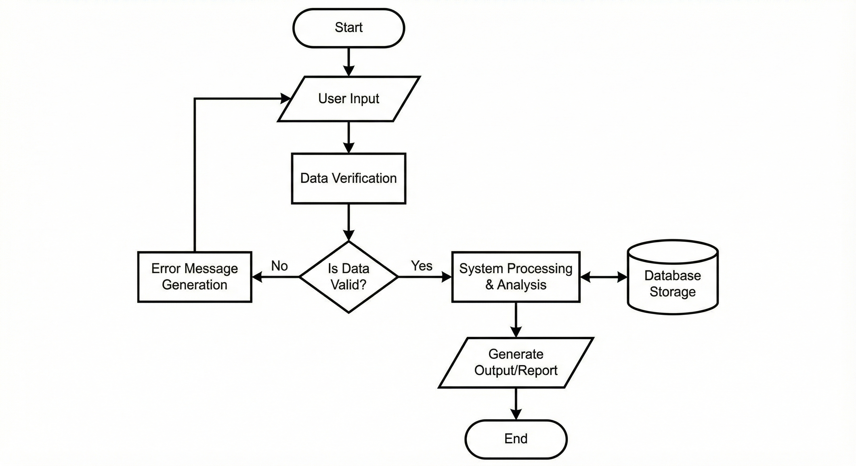
Analysis and Design
System flow chart:

Slide 12
Proposed method & Feasibility Study
Proposed Method
AI-based evaluation using Google Gemini
Text extraction for PDF/DOCX/TXT
Image-to-text processing using Gemini's vision capabilities
Scoring model generates accuracy, readability, consistency, and summary
MongoDB stores evaluations, files, and user history
Web interface allows uploads, camera capture, and result visualization
Feasibility Study
Technical: Implemented using Flask + Gemini + MongoDB (feasible)
Operational: Simple UI; users can easily upload or capture pages
Economic: No special hardware required; cloud-based and cost-effective

Slide 13
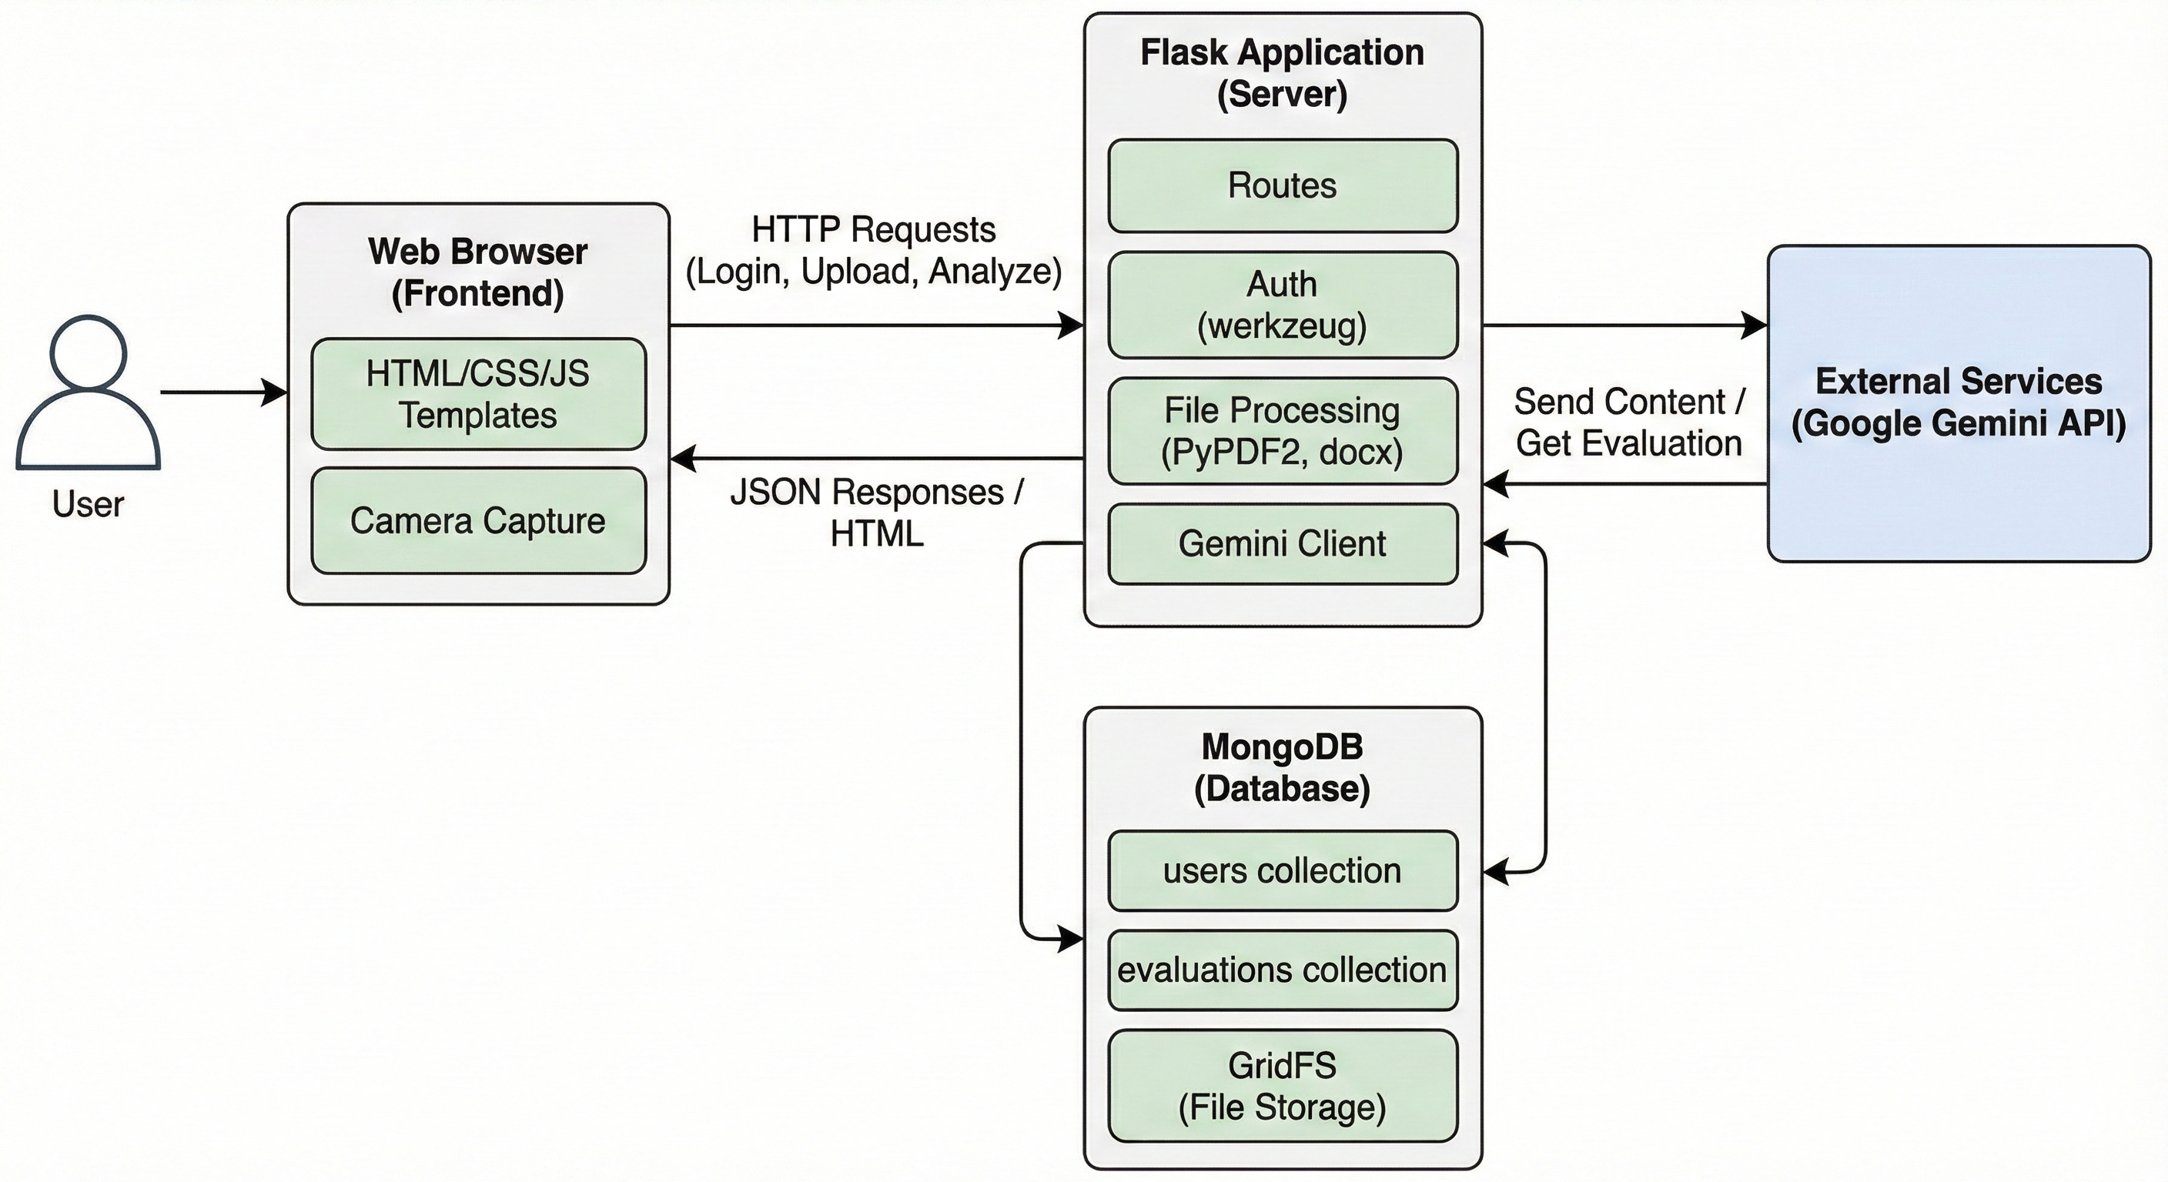
Architecture Diagram

Slide 14
Modules
Authentication Module
Login, Register, Session control
Input Processing Module
File upload, camera capture, MIME identification
Text Extraction Module
PDF, DOCX, TXT extraction
AI Evaluation Module
Gemini-based scoring and summarization
Storage & History Module
MongoDB, GridFS, evaluation retrieval
Presentation Module
Results card, UI rendering, history panel

Slide 15
Hardware and Software details
Hardware
Standard laptop/PC
Minimum 4GB RAM
Webcam (for camera capture option)
Software
Operating System: Windows/Linux
Python 3.x
Flask Framework
MongoDB
Google Gemini API
Libraries: PyPDF2, python-docx, bson, gridfs, werkzeug
Browser (Chrome/Edge)

Slide 16
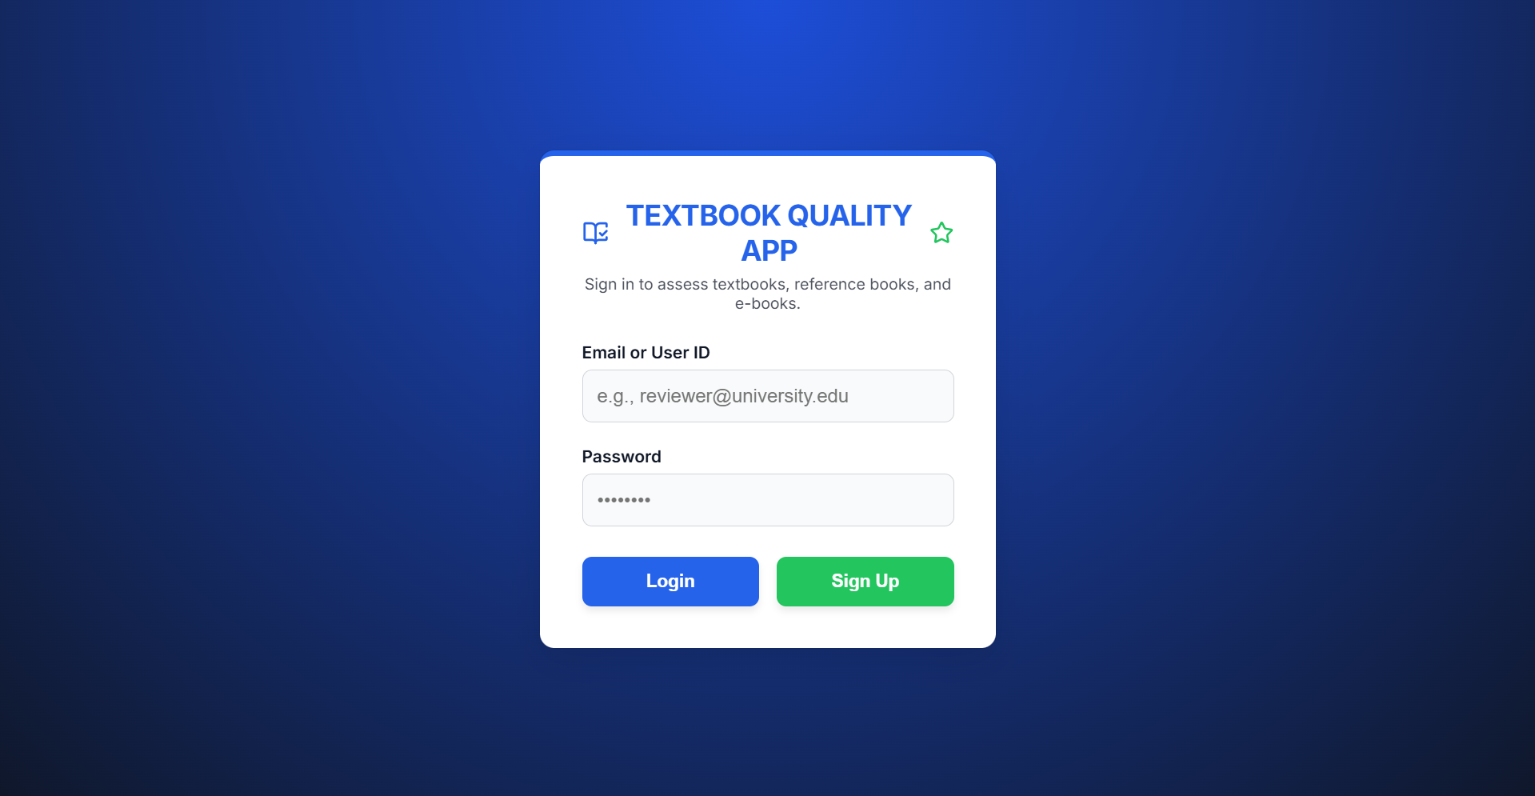
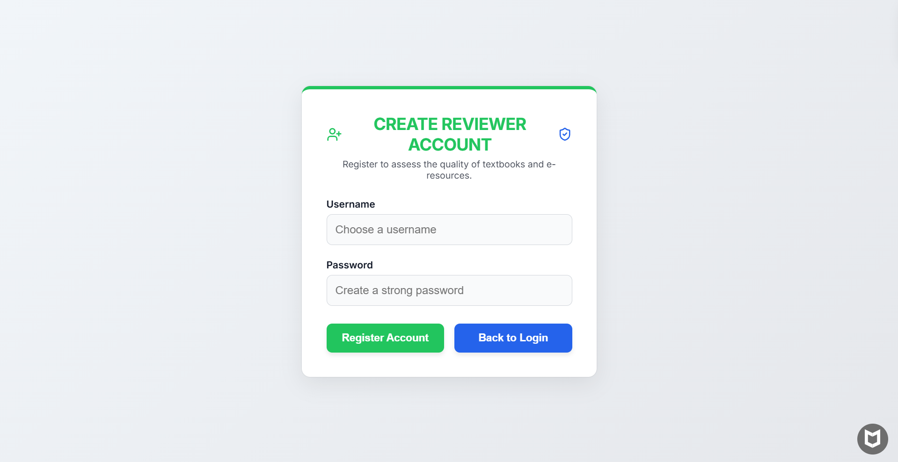
Working Screenshots

Slide 17
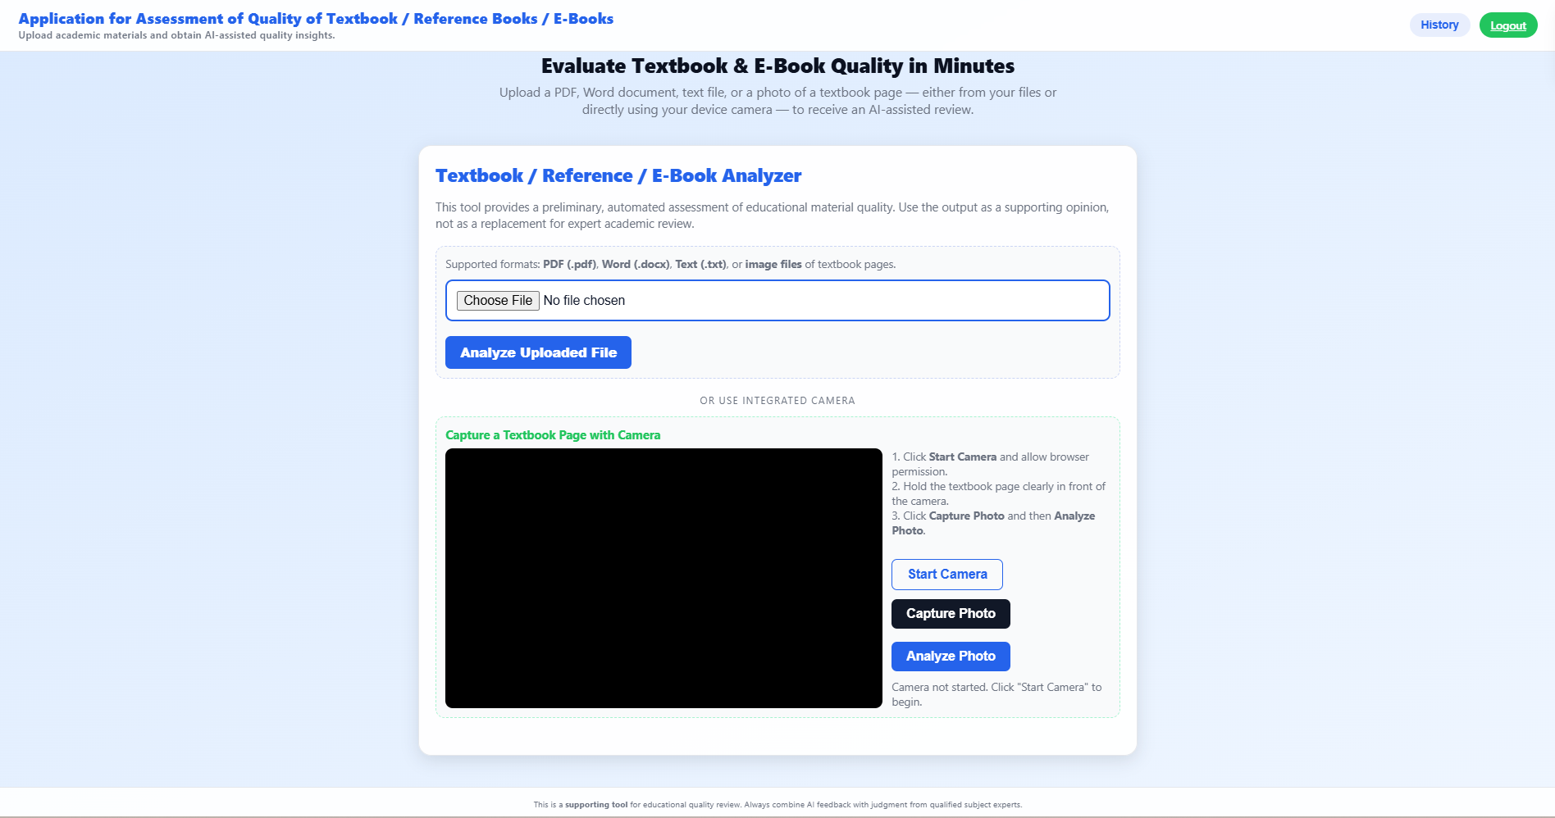
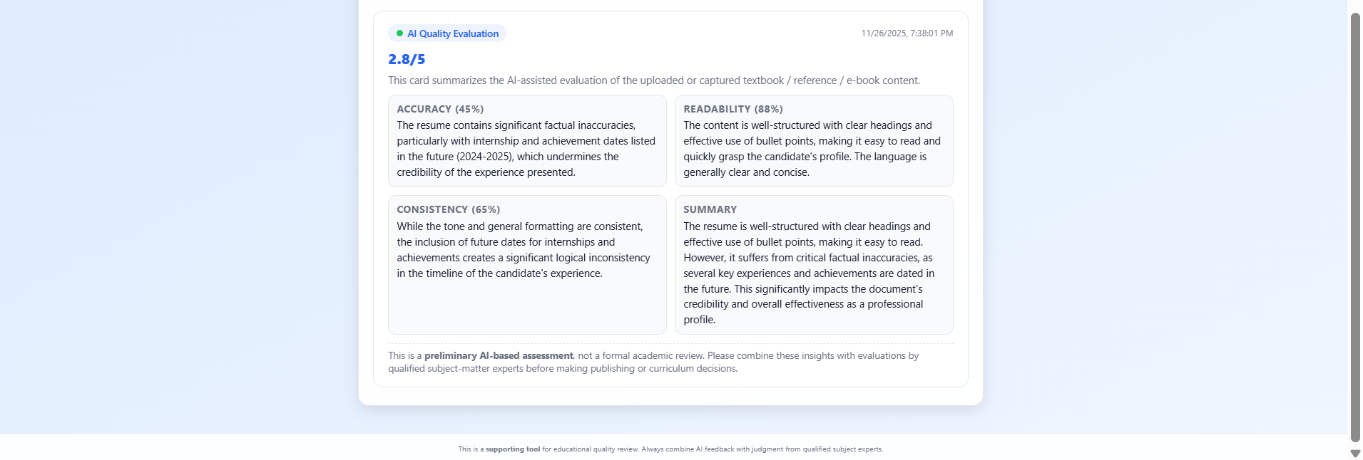
Screenshots

Slide 18
Timeline of the Project (Gantt Chart)
Gantt Chart
Phase | Week 1 | Week 2 | Week 3 | Week 4 | Week 5 | Week 6 | Week 7 | Week 8
1. Requirement Gathering & Analysis | ██████ | ██████
2. Design (UI/UX & Architecture) |  | ██████ | ██████
3. Development (Frontend & Backend) |  |  | ██████ | ██████ | ██████
4. Testing & Debugging |  |  |  |  | ██████ | ██████
5. Deployment & Documentation |  |  |  |  |  |  | ██████ | ██████

Slide 19
References (IEEE Paper format)
[1] Application for Assessment of Quality of Textbook/Reference Book/E-Books, International Journal of Engineering Innovations and Management Strategies, published circa early 2025 (about six months ago) IJEIMS.
[2] Q. Zhou, “Evaluating book impacts via integrating multi-source reviews,” Scientometrics, vol. 129, 2024
[3] R. K. Singh and A. Sharma, "Design and development of web-based evaluation system for academic resources," International Journal of Computer Applications, vol. 183, no. 8, pp. 25–30, June 2021.
[4] S. R. K. Somasekhar, P. V. Kumar, and R. J. Reddy, "Automated assessment of educational content using multi-criteria analysis," in Proc. IEEE International Conf. on Technology for Education (T4E), Mumbai, India, 2020, pp. 215–220.
[5] M. A. Al-Emran, "Towards an intelligent framework for textbook evaluation in higher education," Education and Information Technologies, vol. 24, no. 2, pp. 1453–1468, Mar. 2019.
[6] N. G. T. Izquierdo, L. A. G. Villalobos, and J. D. M. Ramírez, "A framework for the evaluation of e-learning materials," in Proc. IEEE Global Engineering Education Conf. (EDUCON), Abu Dhabi, UAE, 2016, pp. 1129–1134.
[7] T. M. Connolly and E. A. Stansfield, "Evaluating the quality of learning resources: A web-based approach," in Proc. IEEE International Conf. on Advanced Learning Technologies (ICALT), Athens, Greece, 2014, pp. 37–41.

Slide 20


